Slide 1
Data, Environment and Society Exploratory Data Analysis and Data Cleaning

Slide 2
Questions for data cleaning
Do you see missing values?
Are there cells where missing values were obviously filled in?
Are there cells where values are clearly wrong?
Are there values where two entries could mean the same thing? Often human-entered values, e.g.:
canine and k9;
recommend and recommend,
Zürich and Zurich etc

Slide 3
Data merging
How many rows and columns do you have when you start?
How many do you have after the merge?
What’s missing? Is it acceptable to you if you’ve lost some data?
We’ll return to this when we talk about faithfulness and scope.
I wrote a script for the class to use in the upcoming homework that helps decipher what data gets lost.

Slide 4
As we proceed, we’ll play with the PurpleAir data set.
First, a little more on particulate matter (PM).
Many sizes and shapes and can be made up of hundreds of different chemicals.
Some directly from a source: construction sites, unpaved roads, fields, smokestacks or fires.
Most form in the atmosphere by complex reactions of chemicals such as sulfur dioxide and nitrogen oxides

Slide 5
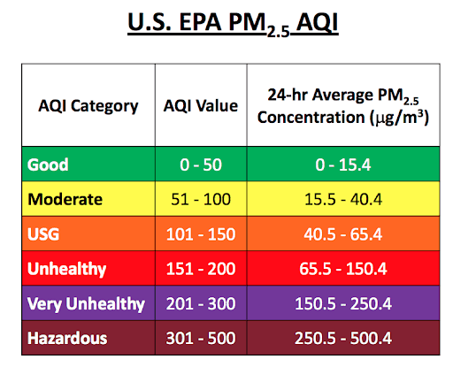
More on PM2.5…
(text adapted from epa.gov) Health effects:
premature death in people with heart or lung disease
nonfatal heart attacks
irregular heartbeat
aggravated asthma
decreased lung function
increased respiratory symptoms, such as irritation of the airways
Environmental effects
makes lakes and streams acidic
changes the nutrient balance in coastal waters and large river basins
depletes soil nutrients
damages sensitive forests and farm crops
affects the diversity of ecosystems
contributes to acid rain

Slide 6
Exploratory Data Analysis (EDA)
One can approach EDA by asking questions about the data:
Structure
Granularity
Scope
Temporality
Faithfulness

Slide 7
Structure – how are the data stored?
Are the data in a standard format or encoding?
Tabular data: CSV, TSV, Excel, SQL
Nested data: JSON, XML
Are the data organized in records (e.g. rows)? If not, can we define records by parsing the data?
Are the data nested? If so, can we reasonably un-nest the data?
Why would we ant to do this?
Do the data reference other data? If so, can we join the data?
What are the fields (e.g. columns) in each record? What is the type of each column?

Slide 8
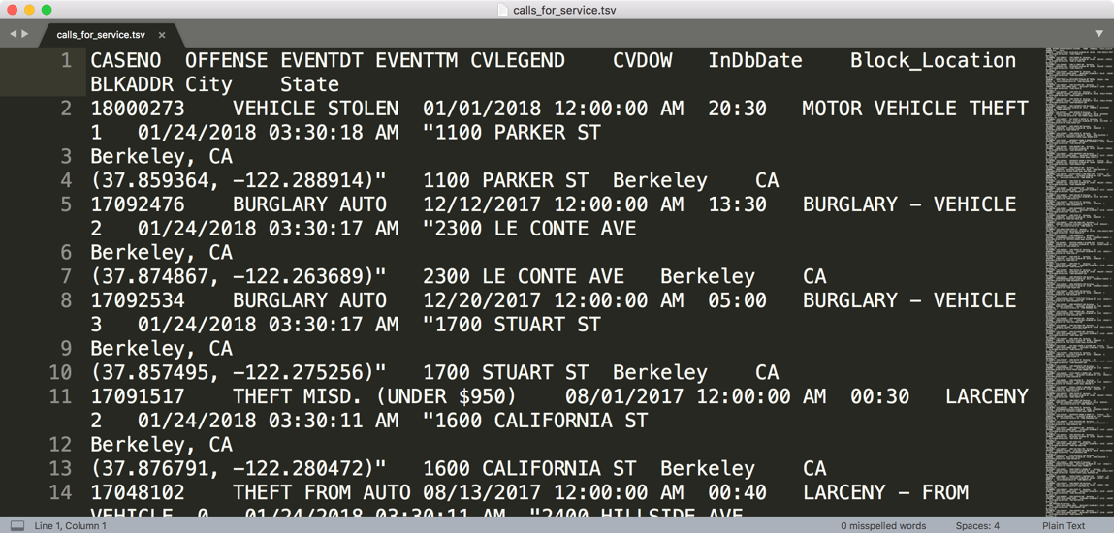
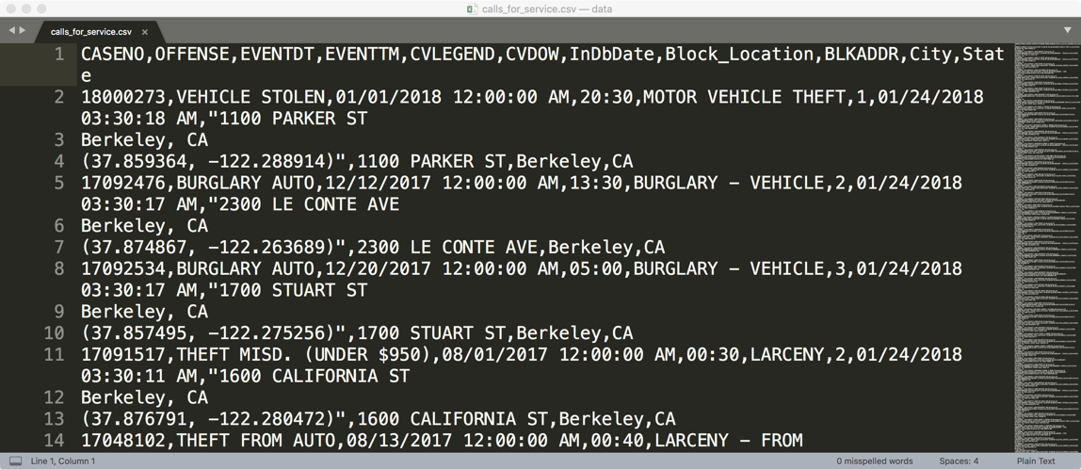
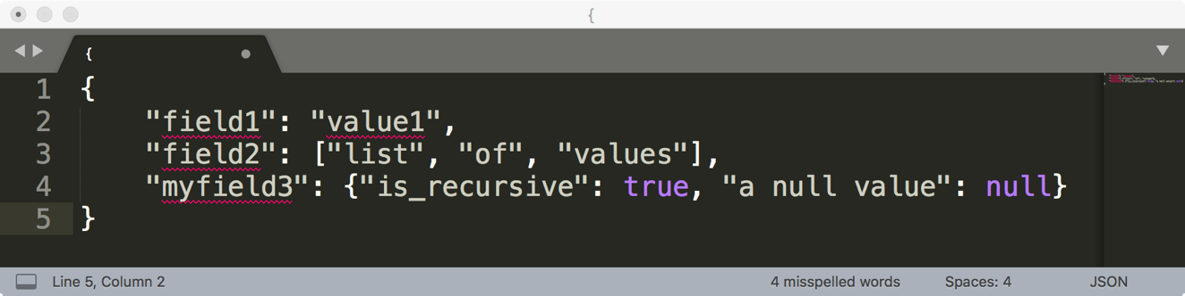
How are these data files formatted?
TSV
Tab separated values
Which is the best?
CSV
Comma separated values
JSON

Slide 9
Comma and Tab Separated Values Files
Tabular data where
records are delimited by a newline: “\n”, “\r\n”
Fields are delimited by ‘,’ (comma) or ‘\t’ (tab)
Very Common!
Main issue?
Some things that are part of the record get interpreted as delimiters: Commas, tabs, quotation marks

Slide 10
JavaScript Object Notation (JSON)
Squiggly brackets act as 'containers’
Square brackets holds arrays
Names and values are separated by a colon.
Array elements are separated by commas

Slide 11
JavaScript Object Notation (JSON)
Widely used file format for nested data
Natural maps to python dictionaries (many tools for loading)
Strict formatting ”quoting” addresses some issues in CSV/TSV
Issues
Each record can have different fields
Nesting means records can contain records → complicated
Side note: look at the “raw” form of the .ipynb files! (They’re JSON.)

Slide 12
Let’s dig into today’s jupyter notebook

Slide 13
Granularity – how are the data aggregated?
What does each record represent?
a purchase, a person, a group of users?
A home, a city, a country?
A minute, an hour, a year?
Do all records capture granularity at the same level?
Data sometimes includes summaries as records
If the data are coarse, how were they aggregated?
Sampling, averaging, summing…
A note on time series data:
Here granularity addresses what period the data are aggregated (usually, averaged) over
Temporality (coming soon) addresses when and how often measurements are made

Slide 14
Scope – how much time, how many people, what spatial area?
Does the data cover the topic of interest?
Subset of a population?
Specific range in time
Specific location
How complete are the data?
Are countries missing?
Are periods of time missing?
These questions matter for assessing external validity. Why?
External validity: how well your model can be expected to apply to other settings
Simply: If your observations aren’t taken from the process you want to model, then you need to cautiously apply your model in new contexts

Slide 15
Temporality: How is time represented in the data?
What is the meaning of the date and time fields in the dataset?
Beware of time zones, daylight savings!
What representation do the date and time fields have in the data?
This topic blurs into granularity!
But here we ask: when and how often?
Granularity asks: Over what duration are the data aggregated?

Slide 16
Faithfulness: are the data trustworthy?
Faithful data lack:
Unrealistic or incorrect values
Violations of obvious dependencies
E.g. age and birthday for individuals don’t match
E.g. sorting by record ID gives different result than sorting by time in PurpleAir data
Hand-entered data
Spelling errors, etc.
Clear signs of falsified data
E.g. repeated names, fake looking email addresses, or repeated use of uncommon names or fields.

Slide 17
Summary: How do you “do” EDA?
Examine data and meta-data:
What is the date, size, organization, and structure of the data?
Examine each field/attribute/dimension individually
Examine pairs of related dimensions
Stratifying earlier analysis: break down grades by major …
Along the way:
Visualize/summarize the data (next time!)
Test your assumptions about the data, for example
“The range should be…”
“Sudden changes should not occur...”
Identify anomalies and either change update your assumptions or modify the data.
Record everything you do! (why?)

